Slide 1
BPMN → SpecIF Transformation
SpecIF:precedes
♦ Case 1
SpecIF:precedes
■ Action 2
■ Action 1
SpecIF:precedes
■ DecisionNode
SpecIF:precedes
♦ Case 2
SpecIF:precedes
■ Action 3

Slide 2
BPMN → SpecIF Transformation
■ Action 1
SpecIF:precedes
■ JoiningNode
SpecIF:precedes
■ Action 3
■ Action2
SpecIF:precedes

Slide 3
BPMN → SpecIF Transformation
■ Partition
SpecIF:contains
■ Action 1
SpecIF:precedes
■ Action 2
SpecIF:precedes
■ Action 3

Slide 4
Archimate → SpecIF Transformation
■ ERP
SpecIF:contains
SpecIF:contains
SpecIF:contains
■ SCM
SpecIF:communicatesWith
■ FiCo
SpecIF:stores
SpecIF:stores
● MDM

Slide 5




Integrate BPMN and Archimate Models using SpecIF
TdSE 2021 Oskar von Dungern, Dr.-Ing., enso managers GmbH

Slide 6
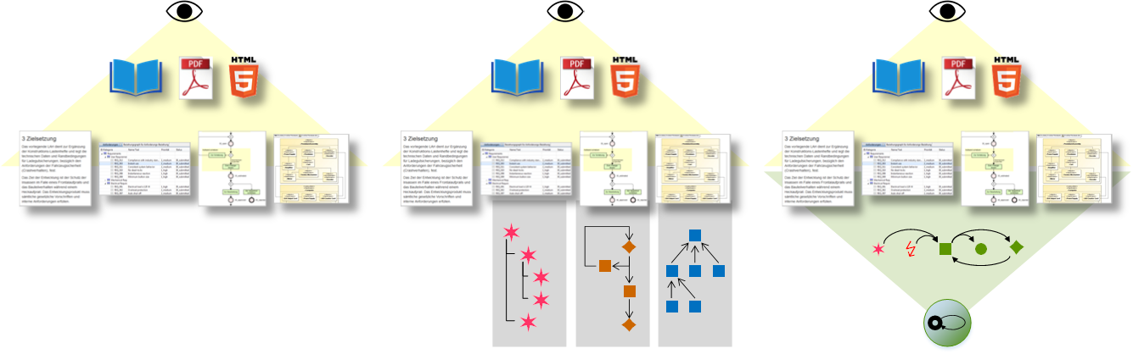

The eye sees the same – behind the surface it gets interesting
Database, ReqIF, OSLC, RDF or …
BPMN
SysML
Creating the „Visible“
Text editing and image „drawing“
Needs brain and discipline to build and keep consistent
Partial Modelling
Text editing and modelling per method
Tool support within the methods
Model Integration
Text editing and modelling per method
Elements in all views are interrelated by a semantic net

Slide 7
Find a Useful Abstraction Level
Model-Integration: Cannot match original model-element types, because there are too many.
Configuration Management: Should only handle a few artefact types.
→ Map to 3 fundamental model-element types ■ Actor, ● State and ♦ Event being common to all notations. (see Fundamental Modelling Concepts by S.Wendt)
PLM/ALM
SpecIF Integration-Model
▣ Diagram
■ Actor
● State
↯ Requirement
3 fundamental Model-element Types
✶ Feature
♦ Event
61 Event Types plus all others
168 Model-element Types 22 Data Types
Excel®
BPMN Process-Model
SysML System-Model
Other Model

Slide 8
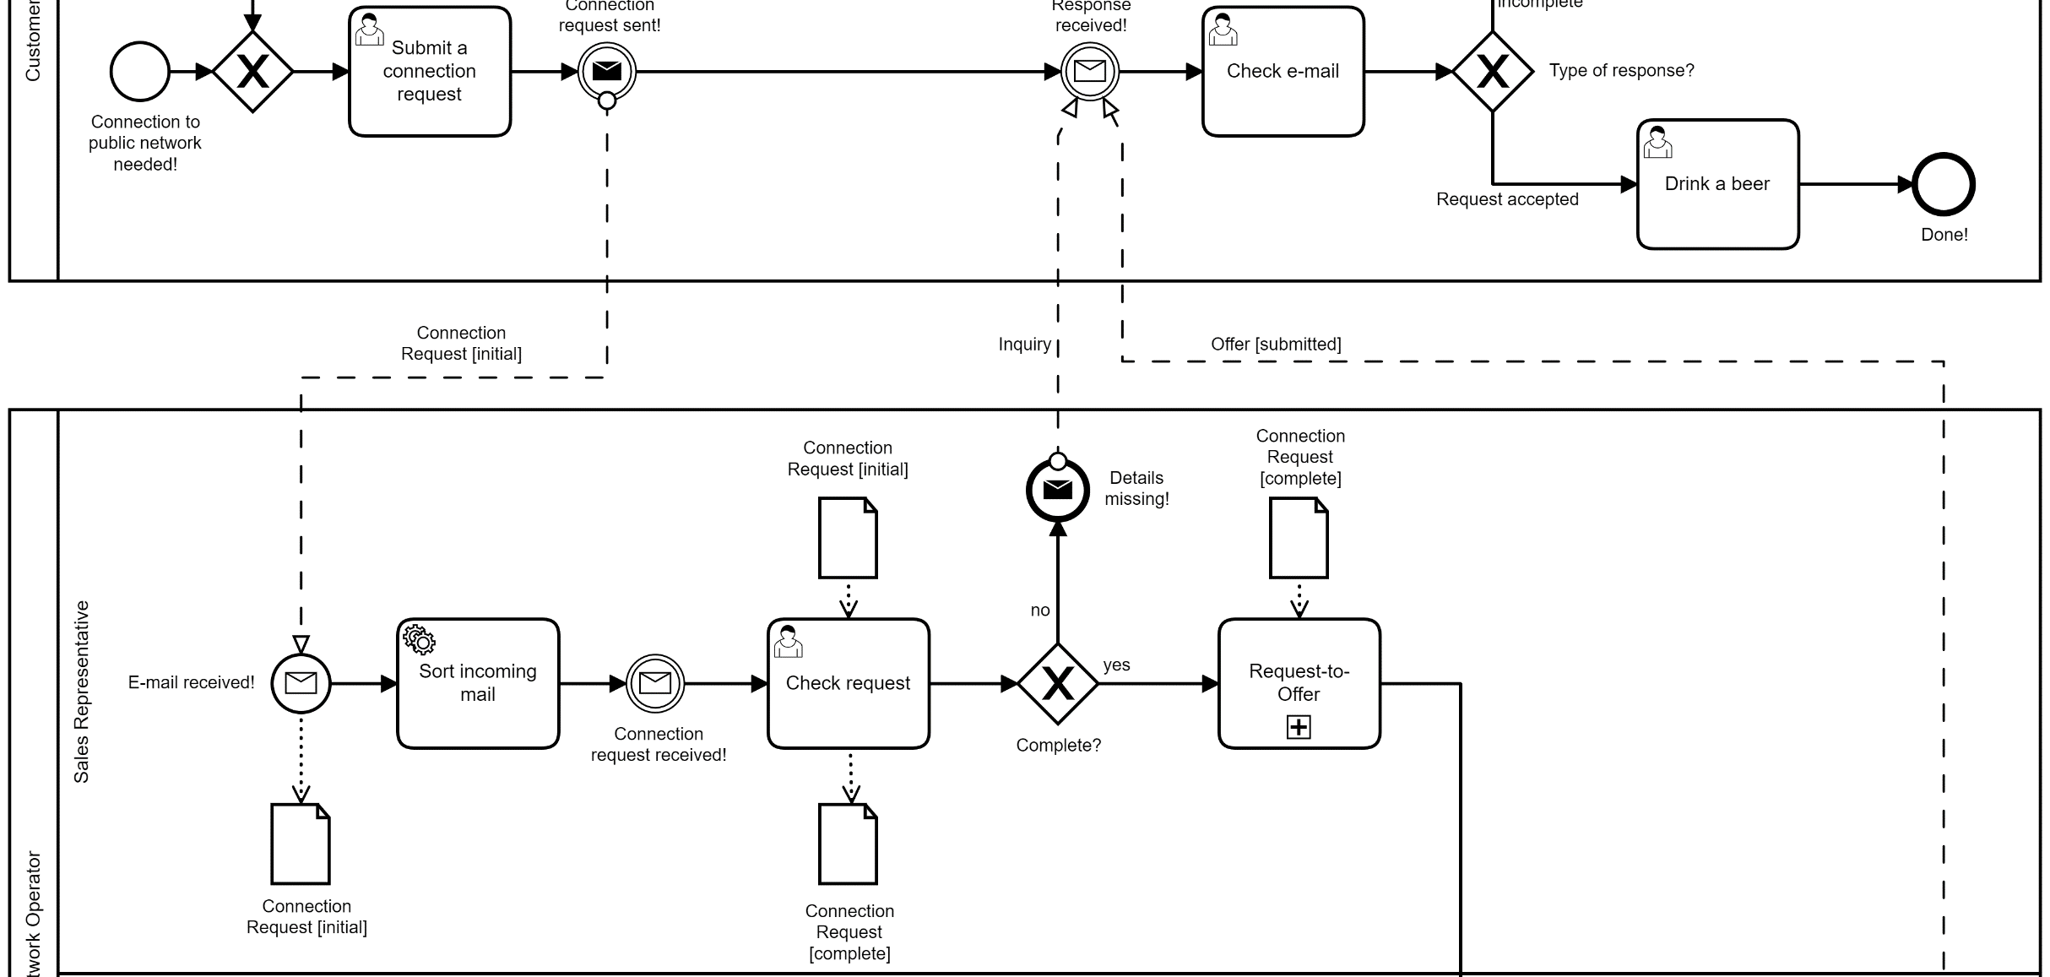
Telephone Connection Request – Business Process (BPMN)

Slide 9
BPMN → SpecIF Transformation
● Connection Request [initial]
♦ Details missing!
SpecIF:precedes
SpecIF:reads
♦ no
♦ Connection request received!
SpecIF:precedes
SpecIF:precedes
■ Check request
SpecIF:precedes
■ Complete?
SpecIF:precedes
♦ yes
SpecIF:writes
● Connection Request [complete]

Slide 10
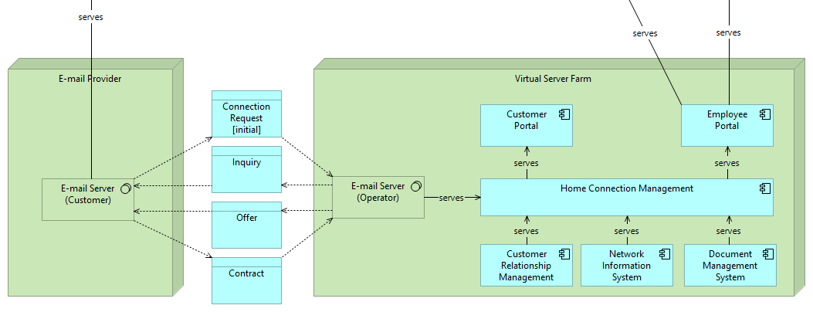
Telephone Connection Request – Application Landscape (Archimate)

Slide 11
Archimate → SpecIF Transformation
● Connection Request [initial]
■ Virtual Server Farm
SpecIF:contains
■ Customer Portal
SpecIF:reads
SpecIF:contains
SpecIF:contains
SpecIF:serves
● Inquiry
■ E-Mail Server (Operator)
■ Home Connection Management
SpecIF:writes
SpecIF:serves
SpecIF:writes
● Offer

Slide 12
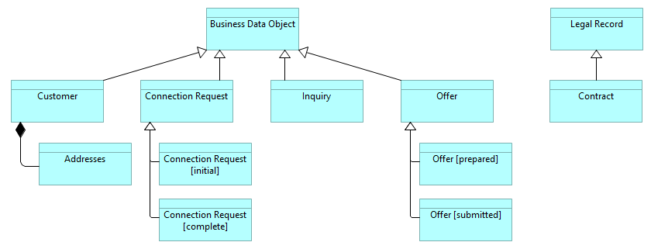
Telephone Connection Request – Class Diagram (Archimate, UML, .. )

Slide 13
Class Diagram → SpecIF Transformation
● Business Data Object
SpecIF:isSpecializationOf
SpecIF:isSpecializationOf
● Customer
● Connection Request
SpecIF:contains
SpecIF:isSpecializationOf
● Addresses
● Connection Request [initial]

Slide 14
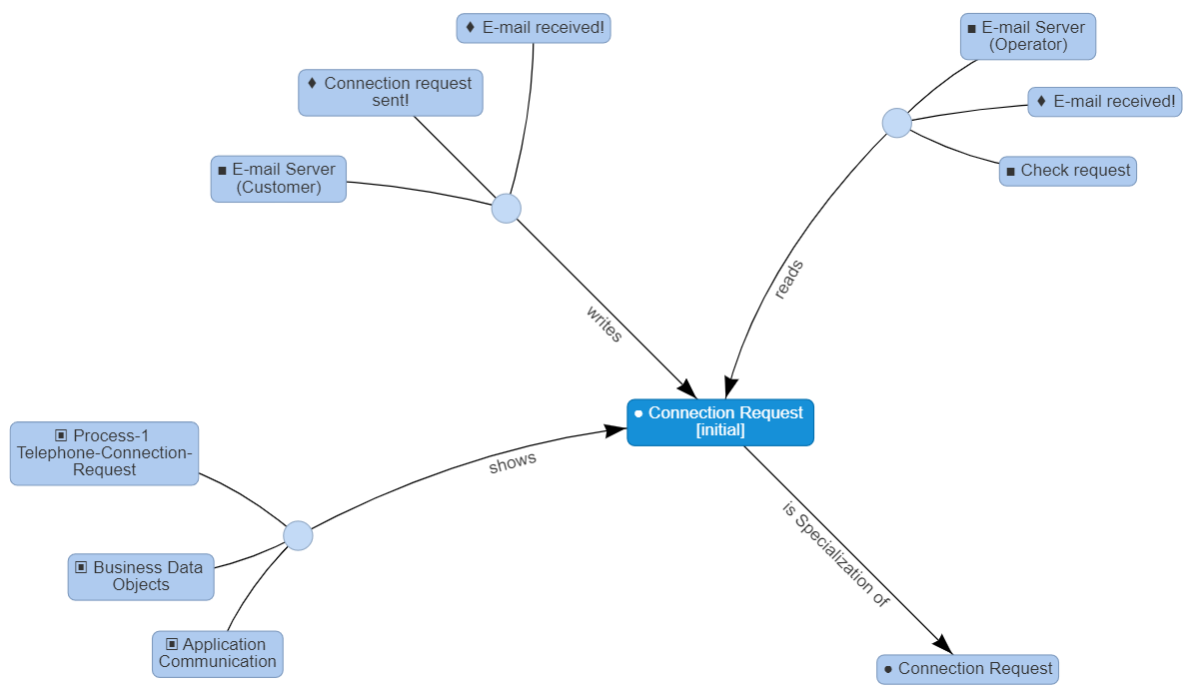
All relations combined → Semantics of a Model-Element

Slide 15
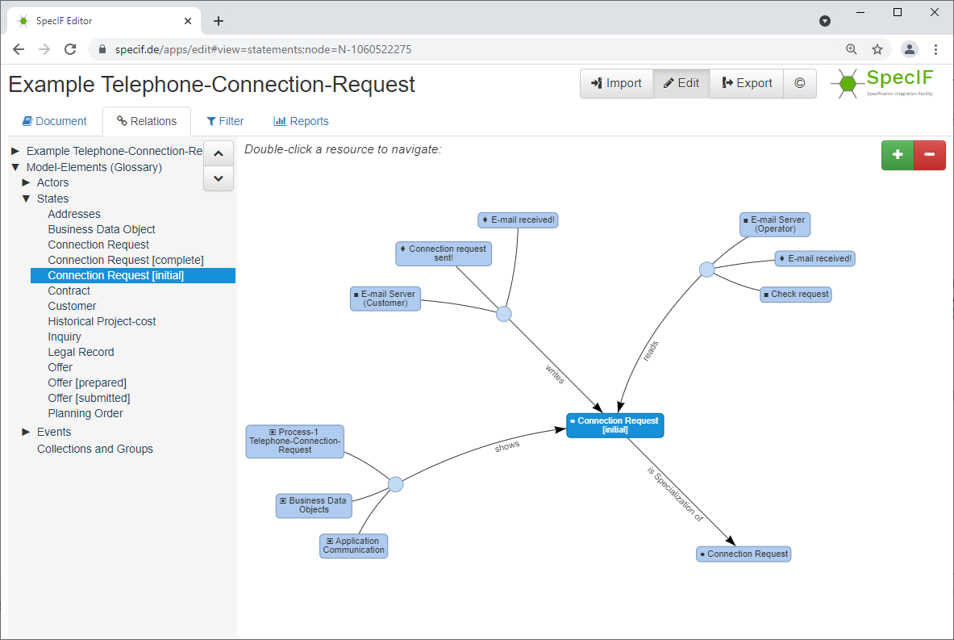
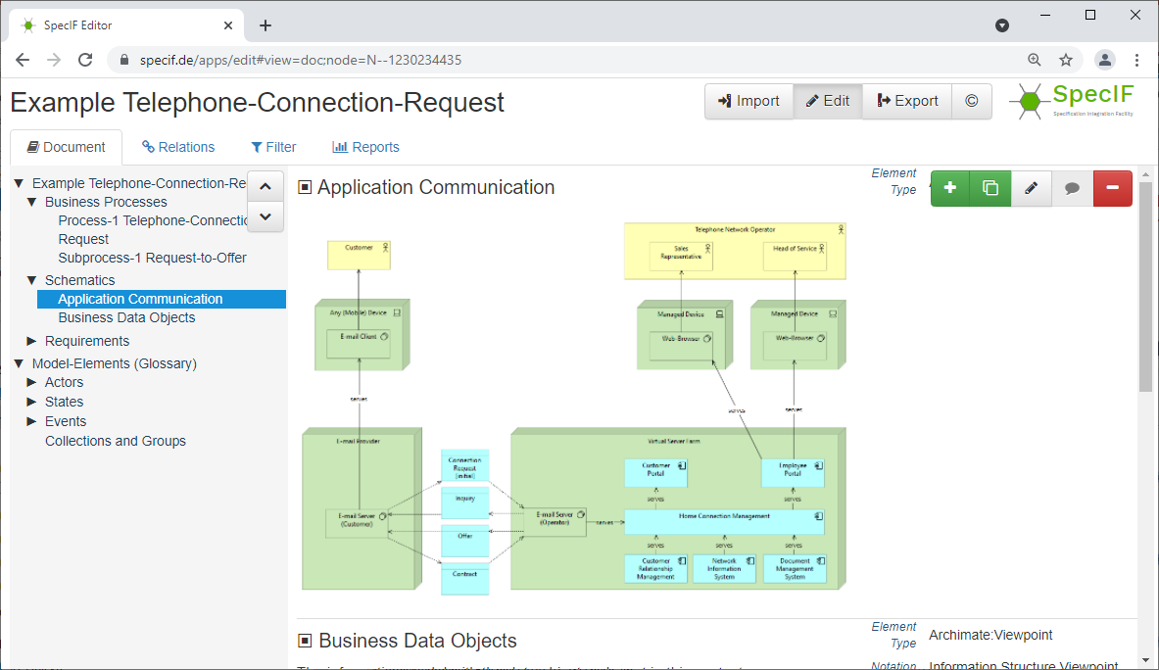
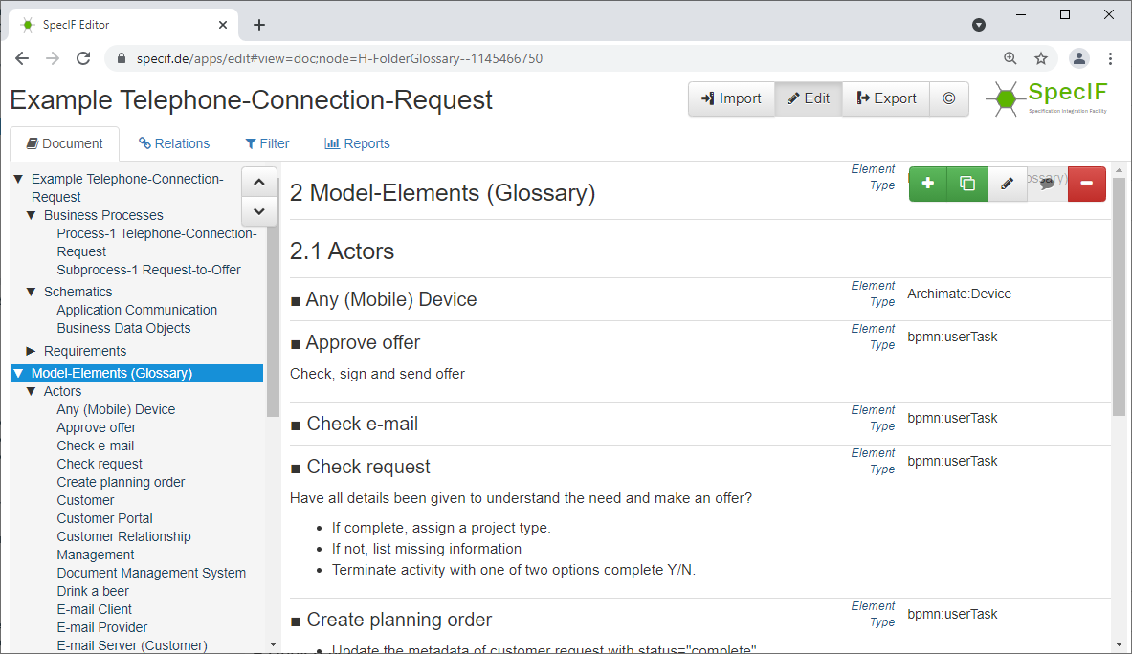

Navigate, search and audit in a common context
All Model-diagrams
All Relations
All Model-elements

Slide 16

Status … see github.com/GfSE
Oliver Alt Oliver Eichmann
available
available
available
available
available
FMC
BPMN
Archi-mate
SysML
Arca-dia
Inter-action Room
ReqIF
Excel
Notation
Specification Integration Facility
ReqIF
SpecIF native
OSLC
linked-data
WIKI
Docu-ment
ePub
Presentation resp. Persistence
(XML)
(JSON)
(RDF)
(Turtle, RDF)
(Confluence)
(DOCX, PDF)
(XHTML)
available (with schema)
available
available
available
available

Slide 17
Resources
SpecIF Home
SpecIF Schema and Tools on GitHub (Open Source, Apache License) → Use the GitHub Ticket System for questions, proposals and requests
Hosted SpecIF Schema and Consistency-check (CORS-enabled, watch for new releases)
SpecIF Viewer und Editor
Examples:
Telephone Connection Request (Notation BPMN+Archimate+XSLX)
System Engineering Collaboration (Notation Archimate)
Dimmer (Notation FMC)
Small Autonomous Vehicle (Notation: SysML)
SpecIF Vocabulary

Slide 18
Literature
[1] Wendt, S.: Ein grundlegender Begriffsrahmen für das Wissensmanagement im Software-Engineering. In Proceedings „Knowtech“ Dresden 2001.
[2] Knöpfel, A.; Gröne, B.; Tabeling, P.: Fundamental Modelling Concepts – Effective Communication of IT Systems. ISBN-13: 978-0-470-02710-3. John Wiley&Sons, Chichester, 2005.
[3] Kaufmann, U., Pfenning, M.: 10 Theses about MBSE and PLM.
[4] Object Management Group: Systems Modeling Language (OMG SysML™), Version 1.3, June 2012.
[5] Object Management Group: Requirements Interchange Format (ReqIF).
[6] Open Services for Lifecycle Collaboration (OSLC).
[7] Specification Integration Facility (SpecIF).
[8] Dungern, O.v.: Semantic Model-Integration for System Specification – Meaningful, Consistent and Viable, 7.Grazer Symposium Virtuelles Fahrzeug, Graz, Mai 2014.
[9] Dungern, O.v.: Integration von Systemmodellen mit fünf fundamentalen Elementtypen. TdSE Tag des Systems Engineering der GfSE, Ulm, November 2015.
[10] Dungern, O.v.: Von Anforderungslisten zu vernetzten Produktmodellen – am Beispiel der Gebäudeautomation. REConf, Unterschleißheim, März 2016.
[11] Dungern, O.v.: Semantic Model Integration for System Specification. TdSE Tag des Systems Engineering der GfSE, Herzogenaurach, October 2016.
[12] Uphoff, F.: Konzept und prototypische Implementierung der Modellintegration der Interaction-Room-Methode in die Specification Integration Facility, Kamp-Lintfort, März 2017.
[13] Mochine, P.; Sünnetcioglu, A.; Dungern, O.v.; Stark, R.: SysML-Modelle maschinell verstehen und verknüpfen. TdSE Tag des Systems Engineering der GfSE, Paderborn, Oktober 2017.
[14] Alt, O.: SpecIF - Die kommende vielschichtige Datenquelle für Spezifikationsdaten. Fachgruppentreffen GI-RE, Nürnberg, November 2018.
[15] Dungern, O.v.: Model-Integration with SpecIF. ProSTEP ivip e.V. SysML-Workflow-Forum November 2019.

Slide 19
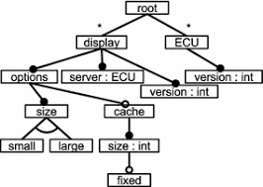











Interessant ?
od@enso-managers.de oliver.alt@mdd4all.de
Varianten-Management
Issue-Management
Requirements
Engineering
Modell-basierte
Entwicklung (MBSE)
ERP-Systeme
Stücklisten
CAD-Daten
Testen

Slide 20
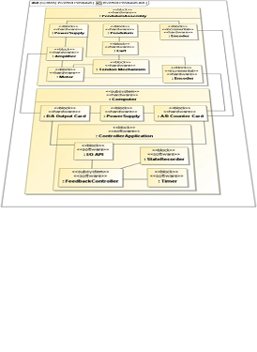
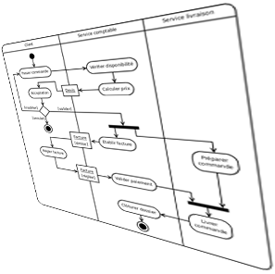
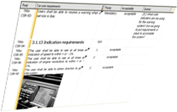
Consolidate model elements from different diagrams
Key to success is the abstraction using 5 fundamental model element types
Impossible with 162 model element types in SysML and almost as many in BPMN
Even within SysML the current tools fail to properly consolidate model elements from different model views
Composition
Requirements
Behavior

Slide 21
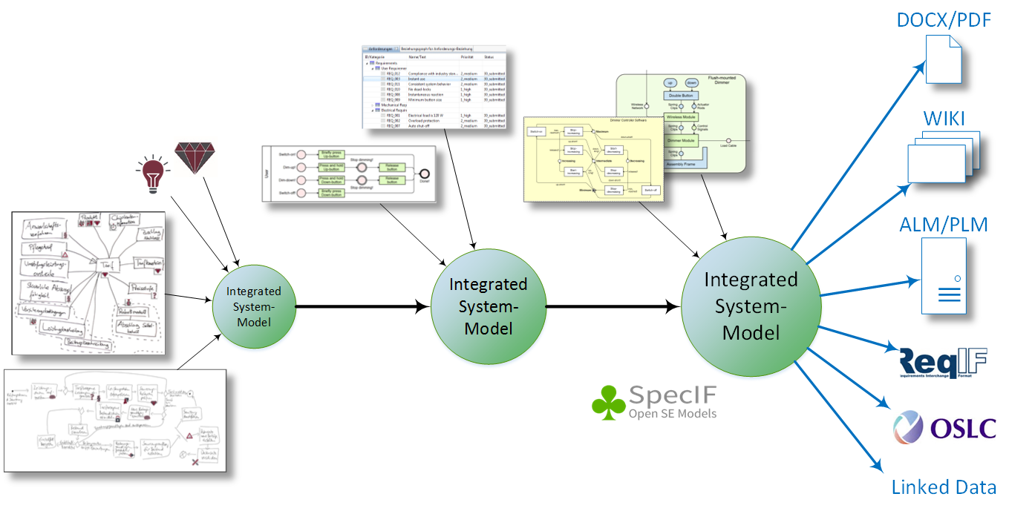
Add partial models step-by-step …
Requirements User Stories
UML/SysML/FMC System models
Processes
System integration
Business objects
Annotations
BPMN Processes
Sichten und Modell trennen.
Modellelemente abstrahieren,
… konsolidieren und
… logisch vernetzen.
http://specif.de

Slide 22
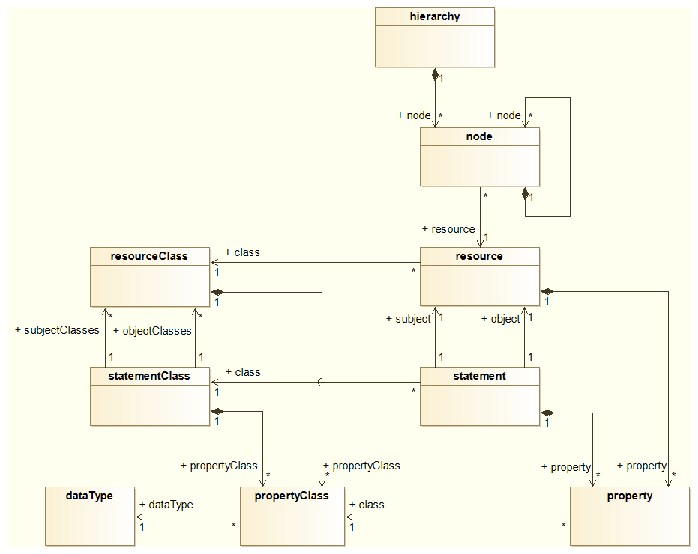
A SpecIF data set contains both the Set types („model“) and the instances („data“ = „payload“)
Hierarchical ordering of Resources (e.g. for convenient reading)
SpecIF model with Resource- and Statement-Classes
SpecIF data (payload) with Resources and Statements
The classes can be defined at runtime („dynamic model“)

Slide 23
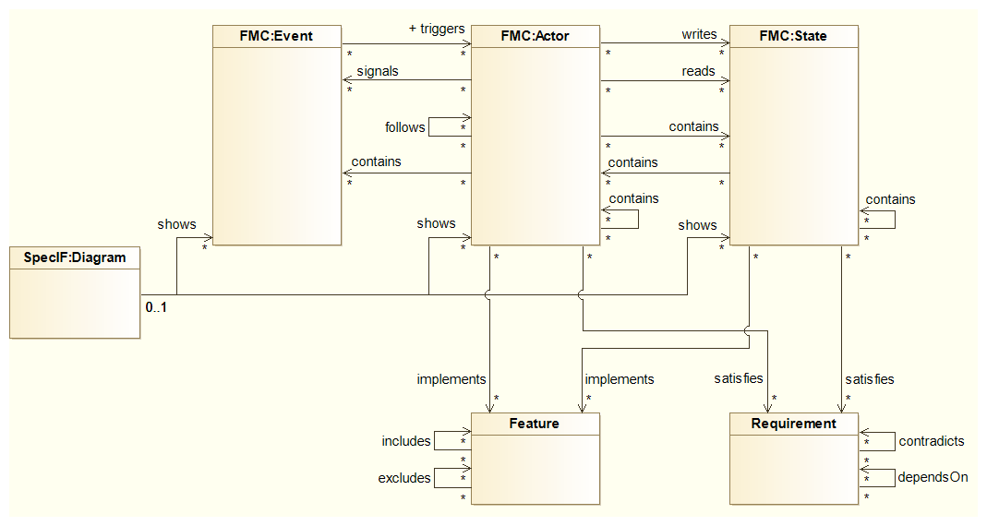
The SpecIF Integration Model with 5 Fundamental Model-element Types
SpecIF resourceClass
♦
■
●
SpecIF ObjectType
Function
Module
Component
Role
Information
Database
State
Form
Color
Eventc
▣
Model Diagram
SpecIF statementClass
SpecIF statementClass
✶
↯
Feature
Requirement

Slide 24
Simple Model-Integration „Adopt“
Adopt existing model-element types, if they are equivalent
Add new diagrams (views)
Adopt existing model-elements having the same title
Add new statements
Build new glossary of model-elements, sorted by fundamental type

